Slide 1

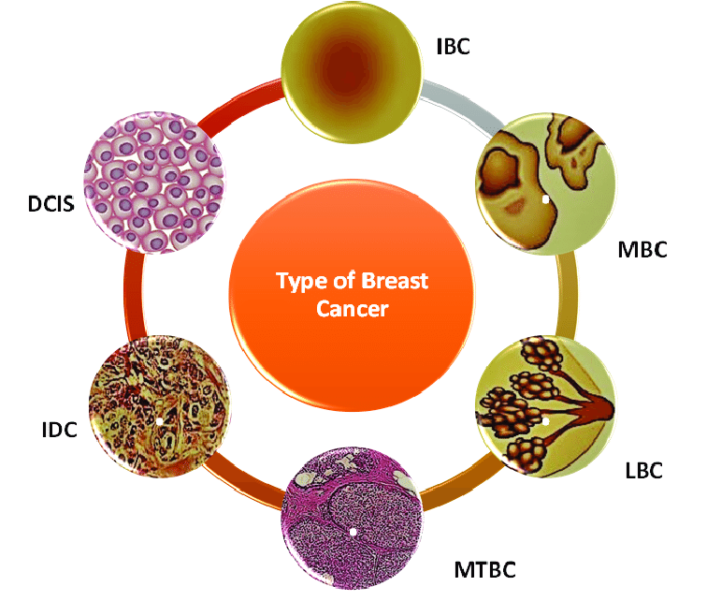
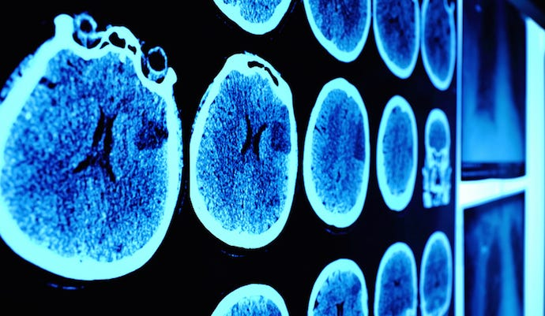


TITLE:
Breast cancer prediction

Slide 2
Name of the student:
Jogu. Uday kiran
Roll number:
2203A52028
TRAINER:
MR . D. RAMESH
Asst. Professor
CSE (AI&ML)

Slide 3
PROBLEM STATEMENT
1
.
Breast cancer is a heterogeneous disease, & the choice of treatment can vary greatly depending on factors like tumor subtype, genetic patient characteristics
Many breast cancer survivors face the risk of cancer recurrence, and early detection of recurrence is critical for timely intervention & development of predictive models for recurrence risk assessment.
Early detection of breast cancer is crucial for improving survival rates and treatment outcomes.
Mammograms are a widely used screening tool, but they can be challenging to interpret accurately.
2
3

Slide 4
INTRODUCTION:
Breast cancer is a complex and highly prevalent disease that affects individuals of all genders and ages worldwide. Accurate and timely prediction of breast cancer outcomes is of paramount importance for effective treatment planning and improving patient survival rates. To address this critical need, this study utilizes a comprehensive dataset encompassing a range of patient characteristics, tumor-related factors, and clinical variables.
The dataset includes essential information such as age and gender, which are fundamental factors in understanding the demographic distribution of breast cancer cases. Additionally, it incorporates valuable biomarker data, including Protein1, Protein2, Protein3, and Protein4, offering insights into the molecular profile of tumors. Tumor stage and histology provide critical information about the extent and nature of the disease, while ER (Estrogen Receptor) status, PR (Progesterone Receptor) status, and HER2 (Human Epidermal Growth Factor Receptor 2) status shed light on the molecular subtype of the cancer, influencing treatment decisions.
This study aims to leverage this rich and diverse dataset to develop predictive models that can assist clinicians in making informed decisions regarding breast cancer management. By analyzing these multifaceted variables, we hope to contribute to more personalized and effective breast cancer care, ultimately improving patient outcomes and reducing the burden of this formidable disease.

Slide 5
Age | Gender | Protein1 | Protein2 | Protein3 | Protein4 | Tumour_Stage | Histology | ER status | PR status | HER2 status | Surgery_type | Date_of_Surgery | Date_of_Last_Visit | Patient_Status
42 | FEMALE | 0.95256 | 2.15 | 0.007972 | -0.04834 | II | Infiltrating Ductal Carcinoma | Positive | Positive | Negative | Other | 20-May-18 | 26-Aug-18 | Alive
54 | FEMALE | 0 | 1.3802 | -0.49803 | -0.50732 | II | Infiltrating Ductal Carcinoma | Positive | Positive | Negative | Other | 26-Apr-18 | 25-Jan-19 | Dead
63 | FEMALE | -0.52303 | 1.764 | -0.37019 | 0.010815 | II | Infiltrating Ductal Carcinoma | Positive | Positive | Negative | Lumpectomy | 24-Aug-18 | 08-Apr-20 | Alive
78 | FEMALE | -0.87618 | 0.12943 | -0.37038 | 0.13219 | I | Infiltrating Ductal Carcinoma | Positive | Positive | Negative | Other | 16-Nov-18 | 28-Jul-20 | Alive
42 | FEMALE | 0.22611 | 1.7491 | -0.54397 | -0.39021 | II | Infiltrating Ductal Carcinoma | Positive | Positive | Positive | Lumpectomy | 12-Dec-18 | 05-Jan-19 | Alive
80 | FEMALE | 0.46647 | 2.5797 | -1.2537 | 0.15154 | III | Infiltrating Ductal Carcinoma | Positive | Positive | Negative | Modified Radical Mastectomy | 25-Jun-18 | 16-Feb-19 | Alive
66 | FEMALE | -0.72486 | -0.28289 | 0.95943 | 0.3509 | II | Infiltrating Ductal Carcinoma | Positive | Positive | Negative | Lumpectomy | 27-Oct-18 | 19-Jun-19 | Alive
36 | FEMALE | 0.46931 | 1.5526 | -0.16524 | -0.27599 | III | Infiltrating Ductal Carcinoma | Positive | Positive | Negative | Modified Radical Mastectomy | 19-Jul-18 | 30-Jun-19 | Alive
58 | FEMALE | -1.2685 | 0.10613 | 1.1352 | -0.39492 | II | Infiltrating Ductal Carcinoma | Positive | Positive | Negative | Other | 15-Jun-18 | 16-Dec-19 | Alive
62 | FEMALE | 0.64934 | 1.8168 | 0.27926 | 0.13228 | II | Infiltrating Lobular Carcinoma | Positive | Positive | Negative | Other | 20-Jun-19
51 | FEMALE | -0.38466 | 0.80609 | -1.6274 | -0.51291 | II | Infiltrating Ductal Carcinoma | Positive | Positive | Positive | Modified Radical Mastectomy | 26-Nov-18 | 28-Dec-19 | Alive

Slide 6
IMPLEMENTATION:
Perceptron:
A perceptron is a fundamental building block of artificial neural networks and serves as a simple model of a biological neuron. It was developed by Frank Rosenblatt in the late 1950s. A perceptron takes a set of binary inputs and produces a binary output based on a weighted sum of these inputs. It can be used for binary classification tasks where it learns to separate data points into two categories.
Here's an explanation of the perceptron with its formula:
Inputs: A perceptron takes multiple binary input values, denoted as x₁, x₂, x₃, ..., xᵢ. These inputs can be either 0 or 1.
Weights: Each input is associated with a weight, denoted as w₁, w₂, w₃, ..., wᵢ. These weights are real numbers and represent the strength of the connection between the input and the perceptron.
Weighted Sum: The weighted sum of the inputs is calculated as follows:
Weighted Sum (Z) = w₁ * x₁ + w₂ * x₂ + w₃ * x₃ + ... + wᵢ * xᵢ
network architectures.
.

Slide 7
The perceptron learning algorithm is used to adjust the weights (including the bias weight) during training to find values that allow the perceptron to correctly classify training data. However, perceptrons have limitations and can only learn to classify linearly separable data. For more complex tasks, multiple perceptrons are typically combined in layers to form a multi-layer perceptron (MLP), which can handle nonlinear relationships by using different activation functions and more complex network architectures.

Slide 8
LOGISTIC REGRESSION:
Logistic regression is a statistical model used for binary classification tasks, where the goal is to predict one of two possible outcomes (e.g., 0 or 1, Yes or No, True or False) based on one or more input features. Unlike linear regression, which predicts a continuous output, logistic regression predicts the probability of the binary outcome. It uses the logistic function (also called the sigmoid function) to model this probability. Here's an explanation of logistic regression with its formula:
Formula: The logistic regression model calculates the probability (P) of a binary event (e.g., the probability of a positive outcome) using the logistic function:
yp=1/1+e^-z​
=>-Y LOG (YP)-(1-Y) LOG (1-YP)

Slide 9

Support Vector Machine or SVM is one of the most popular Supervised Learning algorithms, which is used for Classification as well as Regression problems. However, primarily, it is used for Classification problems in Machine Learning.
The goal of the SVM algorithm is to create the best line or decision boundary that can segregate n-dimensional space into classes so that we can easily put the new data point in the correct category in the future. This best decision boundary is called a hyperplane.
SVM chooses the extreme points/vectors that help in creating the hyperplane. These extreme cases are called as support vectors, and hence algorithm is termed as Support Vector Machine. Consider the below diagram in which there are two different categories that are classified using a decision boundary or hyperplane:
Support Vector Machine Algorithm:
Support Vector Machine or SVM is one of the most popular Supervised Learning algorithms, which is used for Classification as well as Regression problems. However, primarily, it is used for Classification problems in Machine Learning.
The goal of the SVM algorithm is to create the best line or decision boundary that can segregate n-dimensional space into classes so that we can easily put the new data point in the correct category in the future. This best decision boundary is called a hyperplane.

Slide 10
RESULT:
SNO | MODEL | ACCURACY
1 | LOGISTIC | Accuracy: 1.0
2 | SUPPORT VECTOR MACHINE | Accuracy:1.0

Slide 11
KNN (k- nearest neighbour)
KNN is a simple yet effective machine learning algorithm used for classification and regression tasks. In KNN, the fundamental idea is to make predictions based on the majority class or the average value of the K nearest data points in the feature space. KNN is intuitive, easy to implement, and does not require model training, making it particularly suitable for small to medium-sized datasets. However, its computational complexity can become an issue for large datasets, and selecting an appropriate K value is crucial for optimal results. For regression tasks, KNN computes the average of the target values of the K nearest neighbors as the prediction. The choice of the value of K is a critical hyperparameter that affects the algorithm's performance, with smaller K values leading to more flexible but noisy predictions, while larger K values lead to smoother but less flexible predictions. This is about KNN ( K nearest neighbour ).

Slide 12
KNN with boot strap
KNN K-Nearest Neighbors (KNN) with Bootstrap is an extension of the traditional KNN algorithm that incorporates the Bootstrap resampling technique. Bootstrap is a statistical method used to estimate the uncertainty associated with a dataset by repeatedly drawing samples with replacement from the original data. When applied to KNN, Bootstrap can enhance the algorithm's robustness and reliability, especially when dealing with noisy or small datasets.
In KNN with Bootstrap, instead of relying on a single fixed dataset for predictions, multiple bootstrap samples are generated from the original dataset. The KNN algorithm is then applied to each of these resampled datasets independently, resulting in a collection of KNN models. Predictions are made by aggregating the results of these models, typically through majority voting for classification tasks or averaging for regression tasks. This ensemble approach helps reduce the impact of outliers and noise in the data and provides a more stable and accurate prediction. It also allows for the estimation of prediction uncertainty, as one can analyze the variability in predictions across the bootstrapped models. While KNN with Bootstrap can be computationally more intensive due to multiple model training and predictions, it is a valuable technique for improving the robustness of KNN and gaining insights into the reliability of its predictions, making it a useful tool in various machine learning applications. In conclusion, K-Nearest Neighbors (KNN) with Bootstrap offers a powerful and robust extension to the traditional KNN algorithm. By incorporating Bootstrap resampling, this approach enhances the stability and accuracy of predictions, making it particularly beneficial when dealing with noisy or small datasets.

Slide 13
Conclusion
Machine learning offers promising avenues for improving breast cancer prediction.
These models have shown the ability to enhance accuracy and efficiency in detecting breast cancer..
The field is evolving rapidly, with new techniques and models continually emerging.
Ultimately, the goal is to harness the potential of machine learning to improve early detection, treatment, and outcomes for breast cancer patients.

Slide 14
REFERENCES:
GUI Machine learning
Git hub link:
https://github.com/udaaaykiranjogu21342/project.git

Slide 15
THANK YOU…

